Slide 1
Android Studio
Università di Modena e Reggio Emilia
Prof. Nicola Bicocchi (nicola.bicocchi@unimore.it)

Slide 2
Setup
Install JDK: https://www.oracle.com/java/technologies/downloads/
Install Android studio: https://developer.android.com/studio

Slide 3
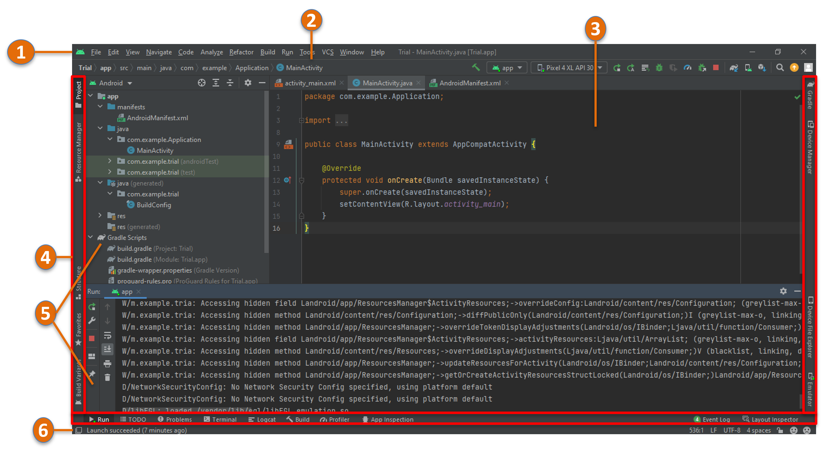
IDE

Slide 4
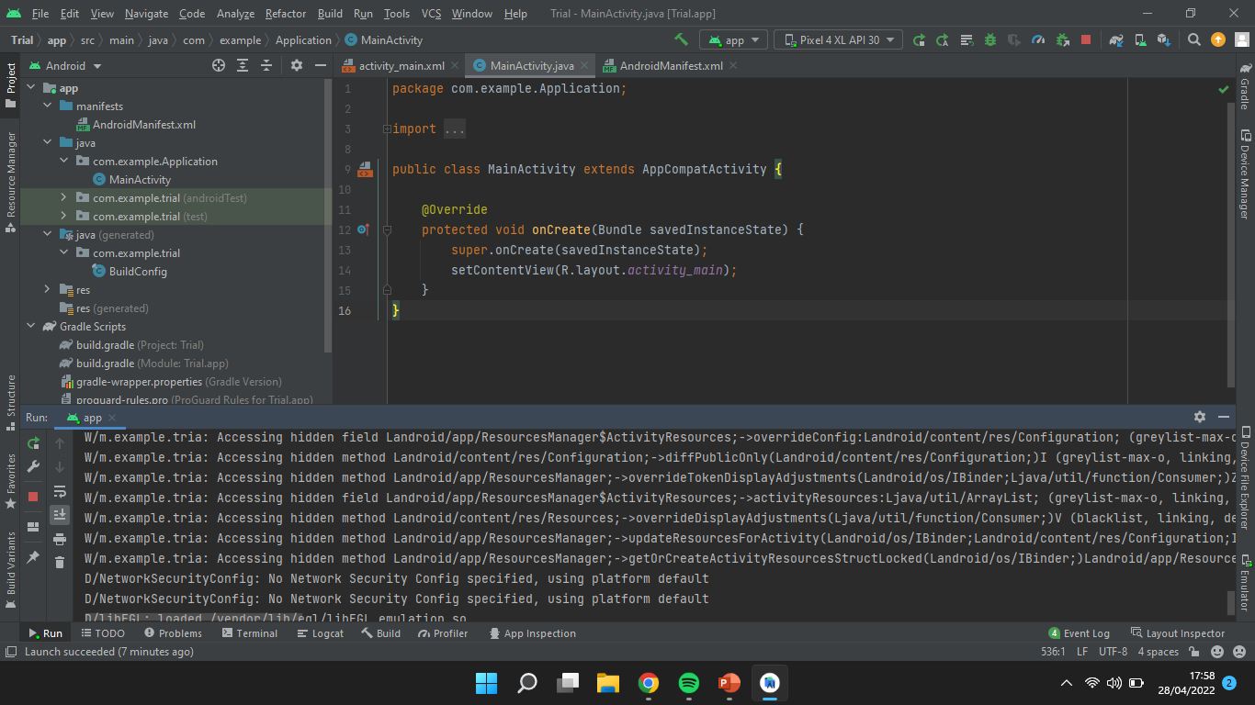
Toolbar & Navigation Bar
1
With toolbar you can carry out a wide range of actions, including running your app and launching Android tools.
2
The navigation bar helps you navigate through your project and open files for editing. It provides a more compact view of the structure visible in the Project window.

Slide 5
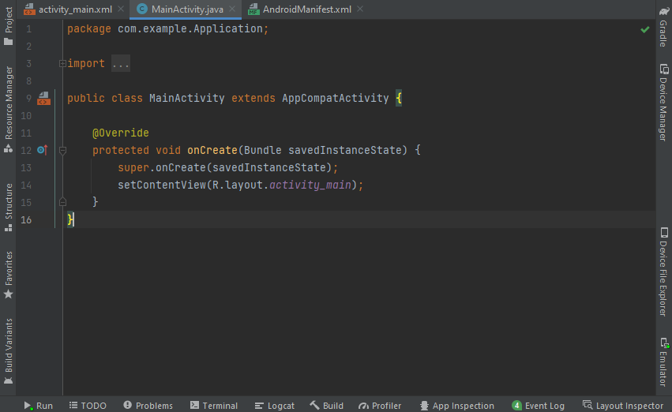
Editor window & Tool window bar
3
With editor window allows you to create and modify code. Depending on the current file type, the editor can change.
Tool window bar runs around the outside of the IDE window and contains the buttons that allow you to expand or collapse individual tool windows.
3
4
4

Slide 6
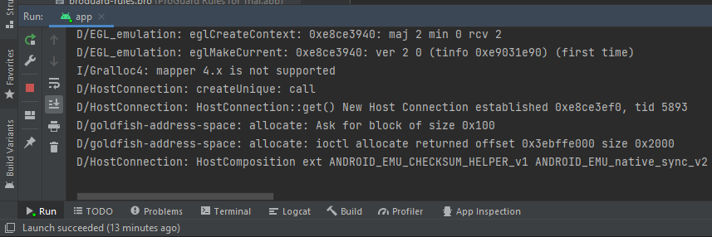
Tool windows & Status bar
5
Tool windows give access to specific tasks like project management, search, version control, and more.
Status bar displays the status of your project and the IDE itself, as well as any warnings or messages.
6
5
6

Slide 7
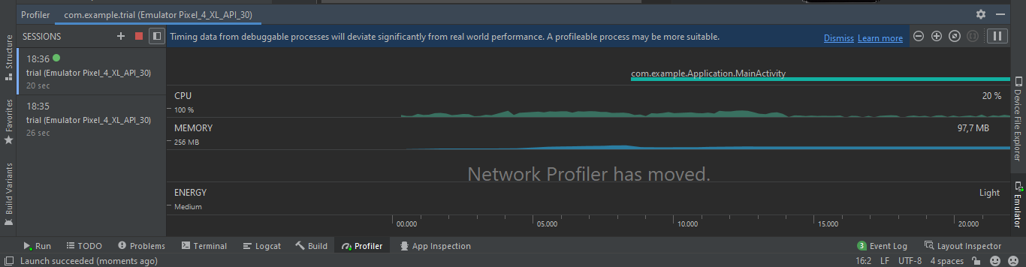
Android Profiler
The Android Profiler in Android Studio 3.0 and higher replaces the Android Monitor tools. The Android Profiler tools provide real-time data to help you to understand how your app uses CPU, memory, network, and battery resources.
Try to run your app and click the tool windows bar on ‘Profiler’

Slide 8
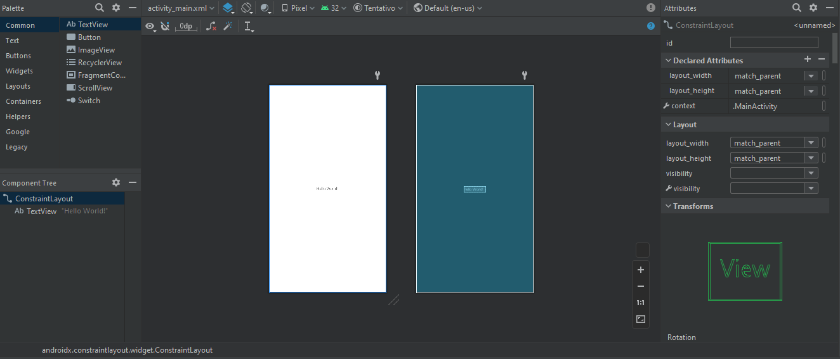
Layout Editor
Where we can add graphic component to our application simply by drag and drop the component, give position constraints and change some attributes like font text, color and so on.

Slide 9
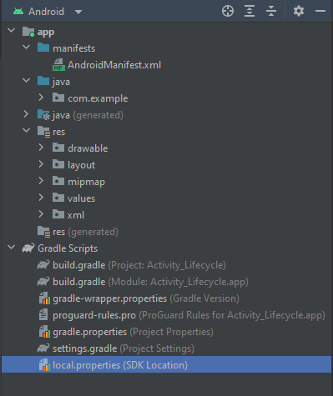
Structure
Our project will be structured
(Android View) as you can see in three directory:
Manifest: contains AndroidManifest.xml where will be declared the activity of our project
Java: contains our java class
Res: contains layout element of our app and the image, sound resource. Also, the .xml files of the classes that define their layout

Slide 10
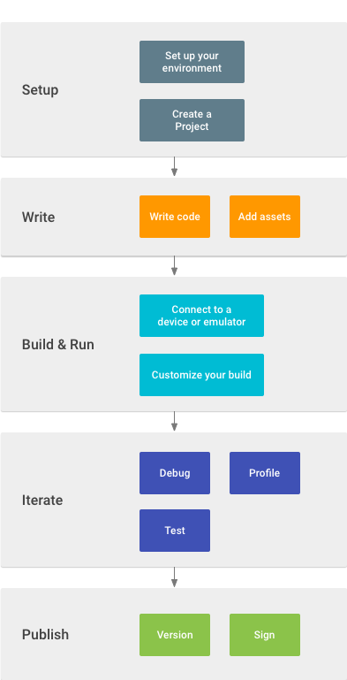
Developer workflow
The workflow must be well defined even before starting a real project, let’s see how it should be structured:

Slide 11
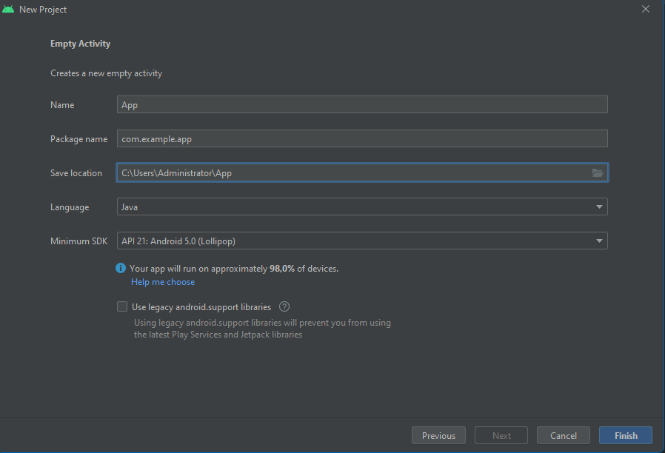
Create a New Project
Create a new project: select Empty Activity
Name: name of the application
Package name: name of package where it will be saved other classes and file in the future
Save location: choose a path in your PC to save the project
Language: language of the project
Minimum SDK: version of operating system (API) for develop you application (will affect on download’s capacity on Play store)
1
2
3
4
5

Slide 12
Important note
Select SDK: It’s important for app’s compatibility according android version on mobile device. You can use API 21:android 5.0. If you want use different SDK, click on ‘Help me to choose’
If you don’t have any SDK installed, you can click ‘finish’ and on IDE click:
File->Settings->Appearance & Behavior->System Settings->Android SDK ->click one SDK->apply.
Automatically android studio will install it for you.
Note: if you need in future to indicate SDK’s path, you can always find it on:
File->Settings->Appearance & Behavior->System Settings->Android SDK

Slide 13
Appearence
Android studio will automatically create an empty activity and its own layout contained on Res/layout/file_layout.xml
<?xml version="1.0" encoding="utf-8"?> <androidx.constraintlayout.widget.ConstraintLayout xmlns:android="http://schemas.android.com/apk/res/android" xmlns:app="http://schemas.android.com/apk/res-auto" xmlns:tools="http://schemas.android.com/tools" android:layout_width="match_parent" android:layout_height="match_parent" tools:context=".MainActivity"> <TextView android:layout_width="wrap_content" android:layout_height="wrap_content" android:text="Hello World!" app:layout_constraintBottom_toBottomOf="parent" app:layout_constraintEnd_toEndOf="parent" app:layout_constraintStart_toStartOf="parent" app:layout_constraintTop_toTopOf="parent" /> </androidx.constraintlayout.widget.ConstraintLayout>
public class MainActivity extends AppCompatActivity { @Override protected void onCreate(Bundle savedInstanceState) { super.onCreate(savedInstanceState); setContentView(R.layout.activity_main); } }

Slide 14
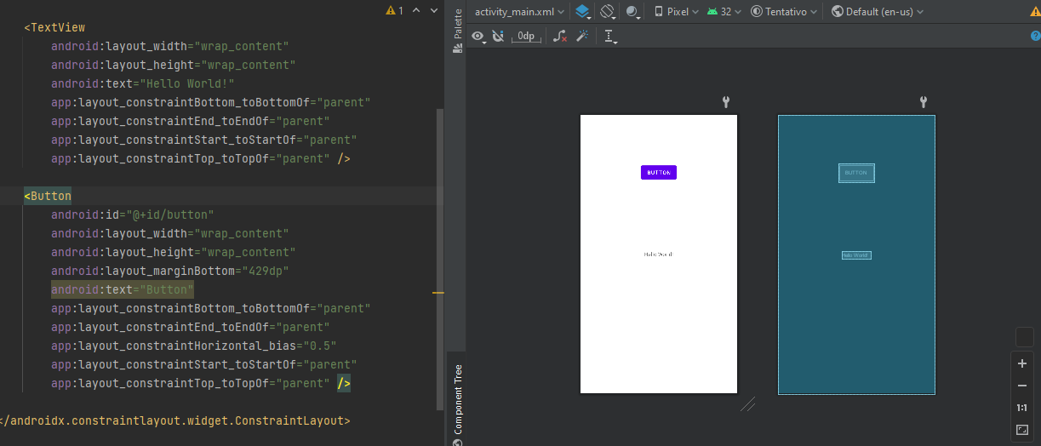
Adding Component
As soon as we add component via Layout editor, XML file or directly on Activity class all this object will be declared into the XML file. To run it we use an emulator.

Slide 15
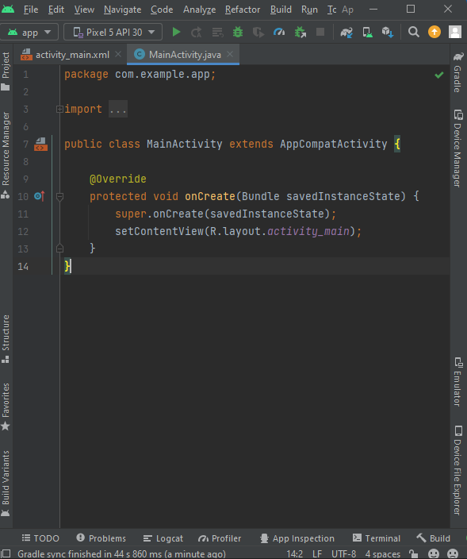
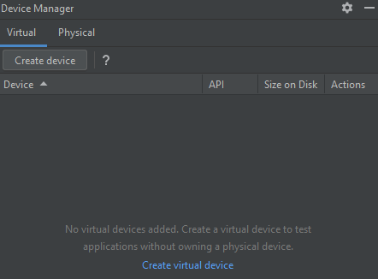
Create an Emulator
Select Device Manager
Click create Device

Slide 16
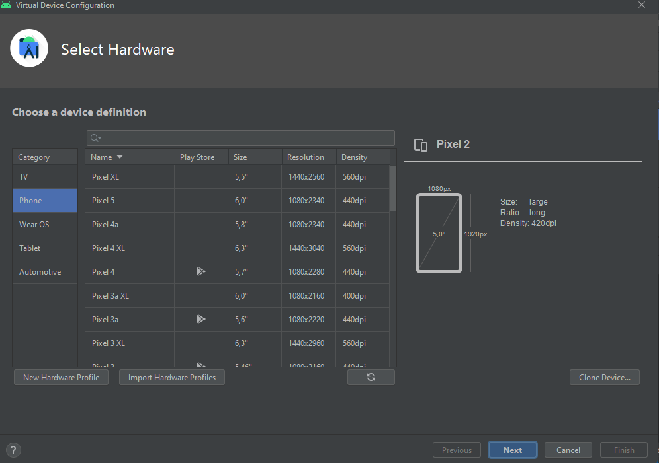
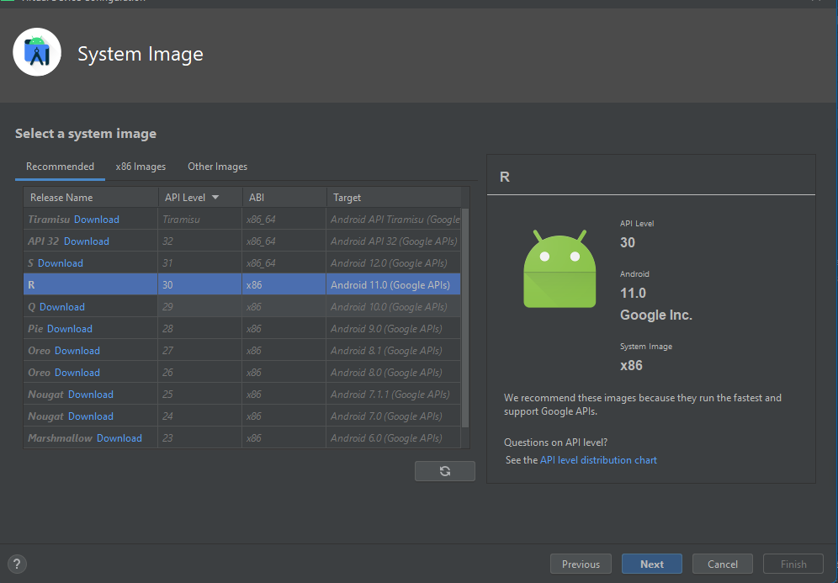
Create an Emulator
Choose the device that fits for your project
In base of which device you choose you have to select the version of android that you want on it

Slide 17
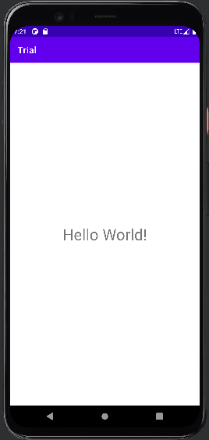
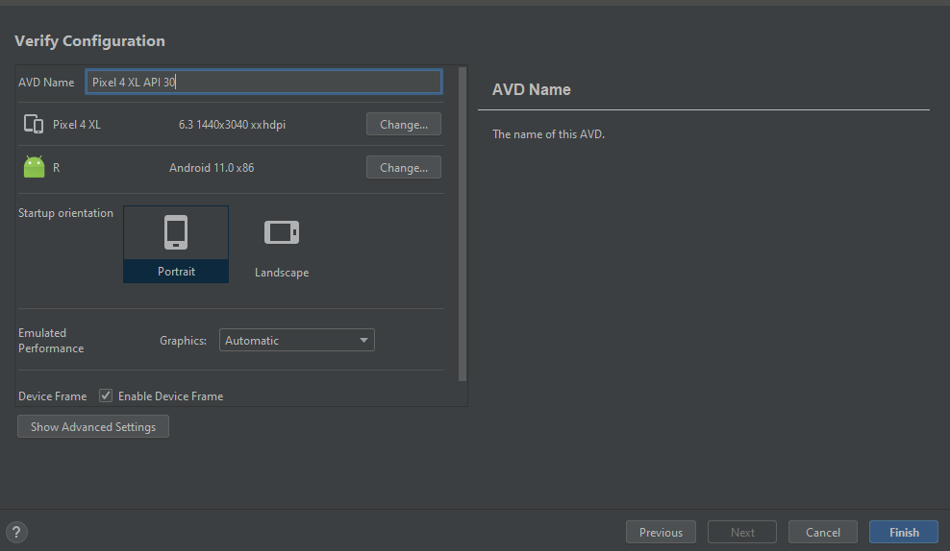

Create an Emulator
Choose a device’s name and its orientation
Now you can run your emulator by pressing “run app”

Slide 18
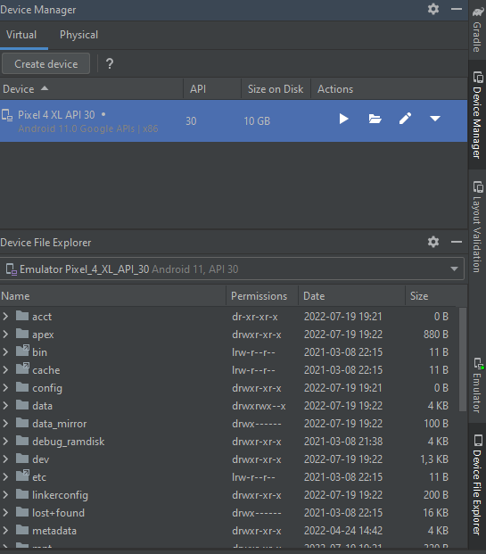
Device Manager
The Device Manager manages all possible emulators that we will create and allows us to:
explore files within our emulated device
Add new emulators
modify existing devices by changing: model, android version, ram memory and internal memory

Slide 19
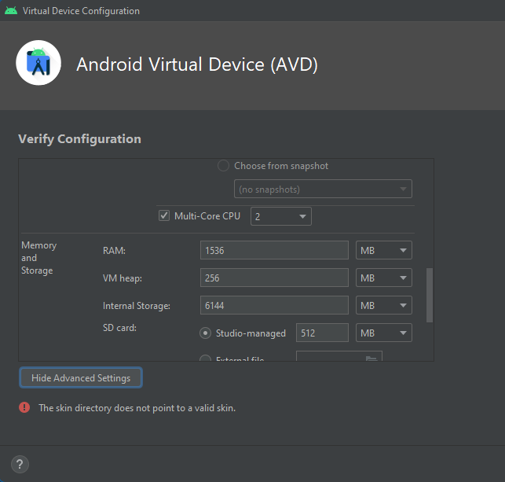
Device Manager
The Device Manager manages all possible emulators that we will create and allows us to:
explore files within our emulated device
Add new emulators
modify existing devices by changing: model, android version, ram memory and internal memory

Slide 20
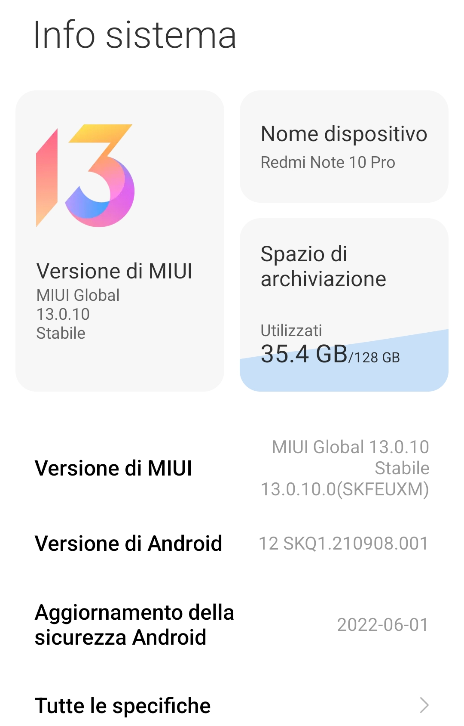
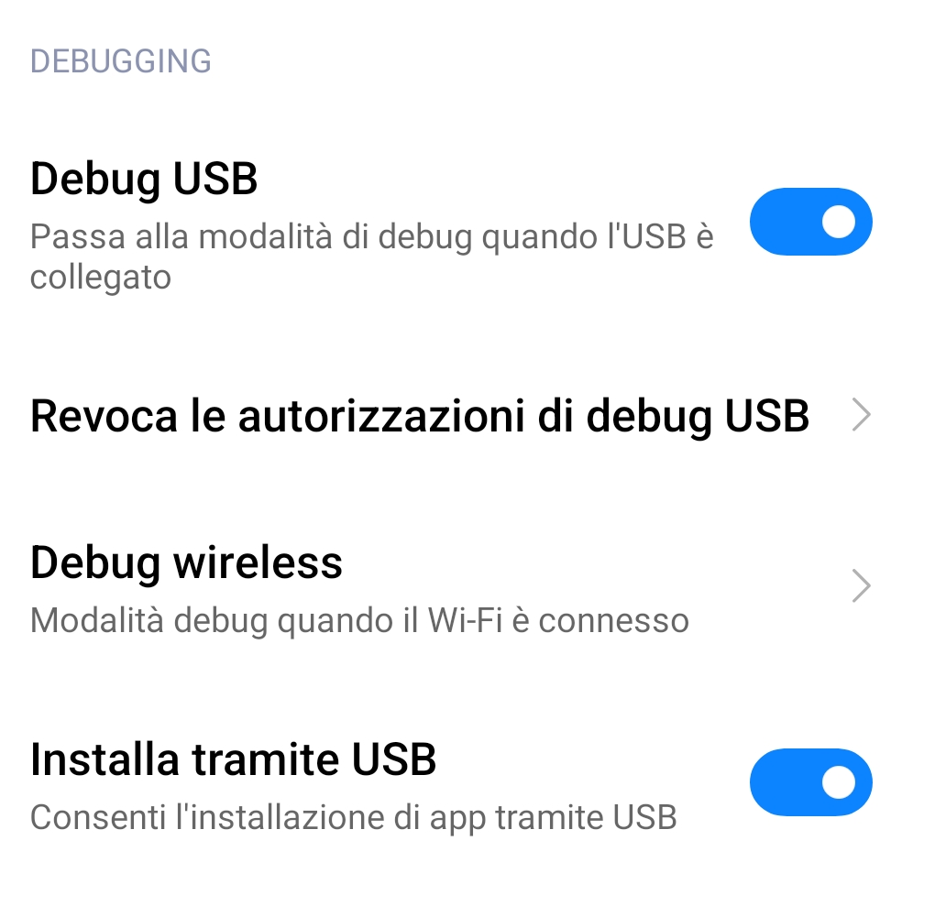
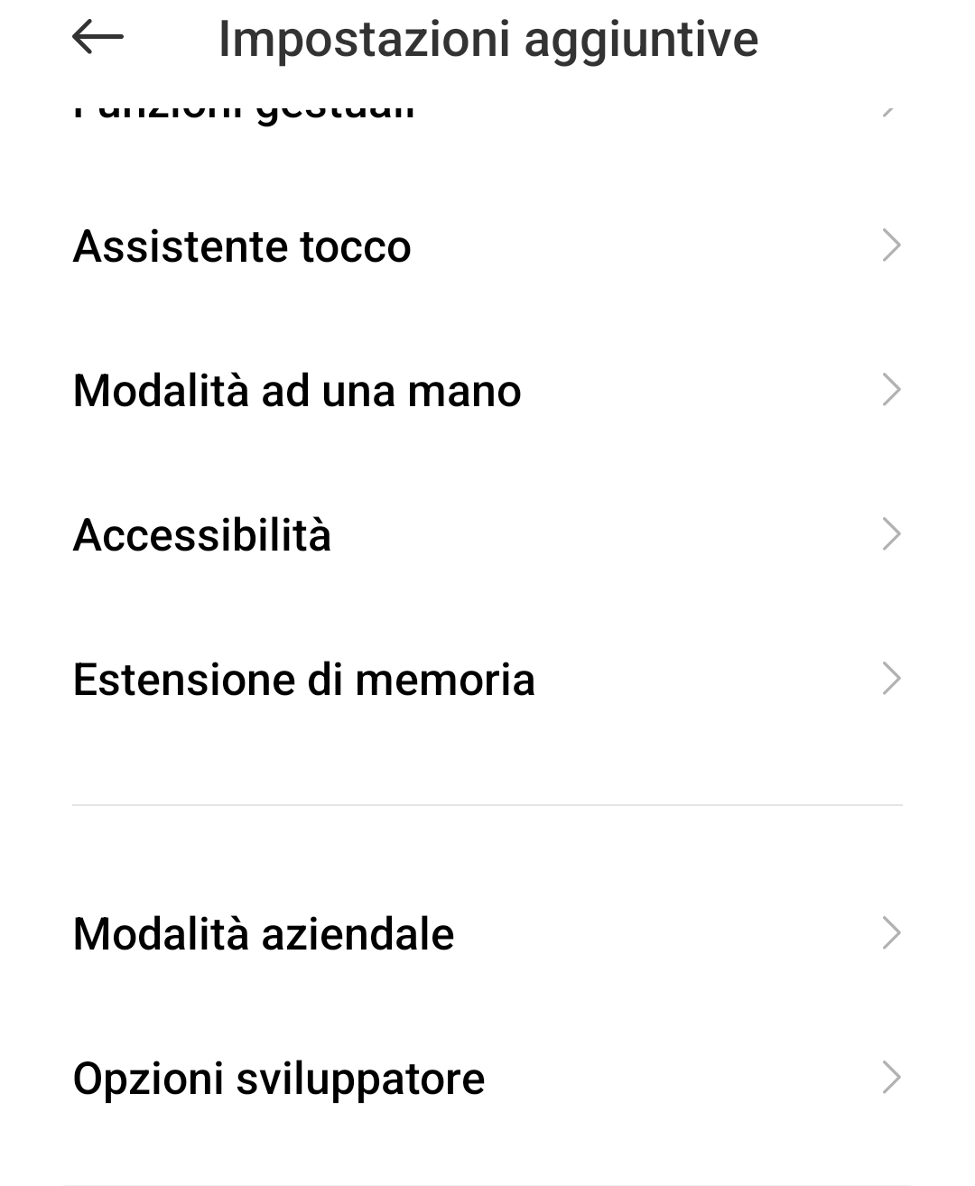
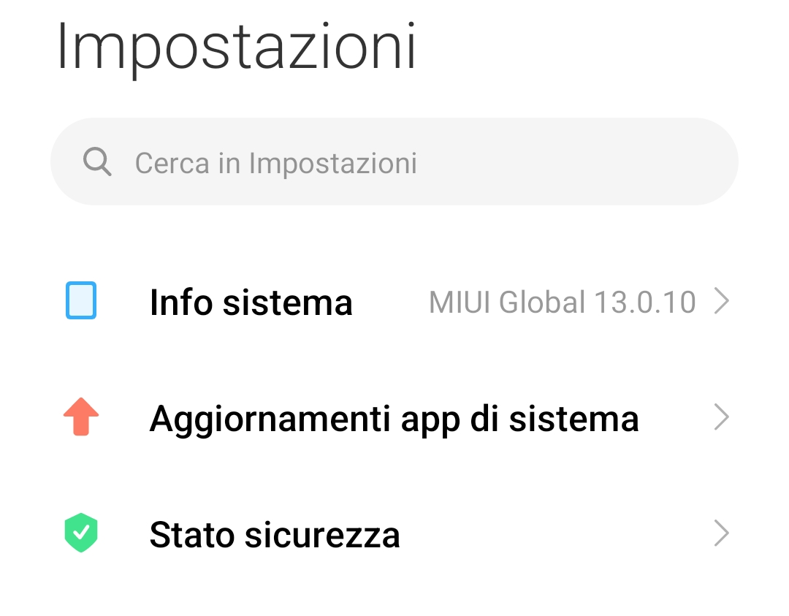
Physical Device
In addition, the device manager allows you to connect real devices in order to run our applications, just go to the settings of the device you want to use, Enable USB debugging and allow USB installation of the app as soon as we try to run it
2
3
4
1

